Slide 1
Unit 5 memory & learning

Slide 2
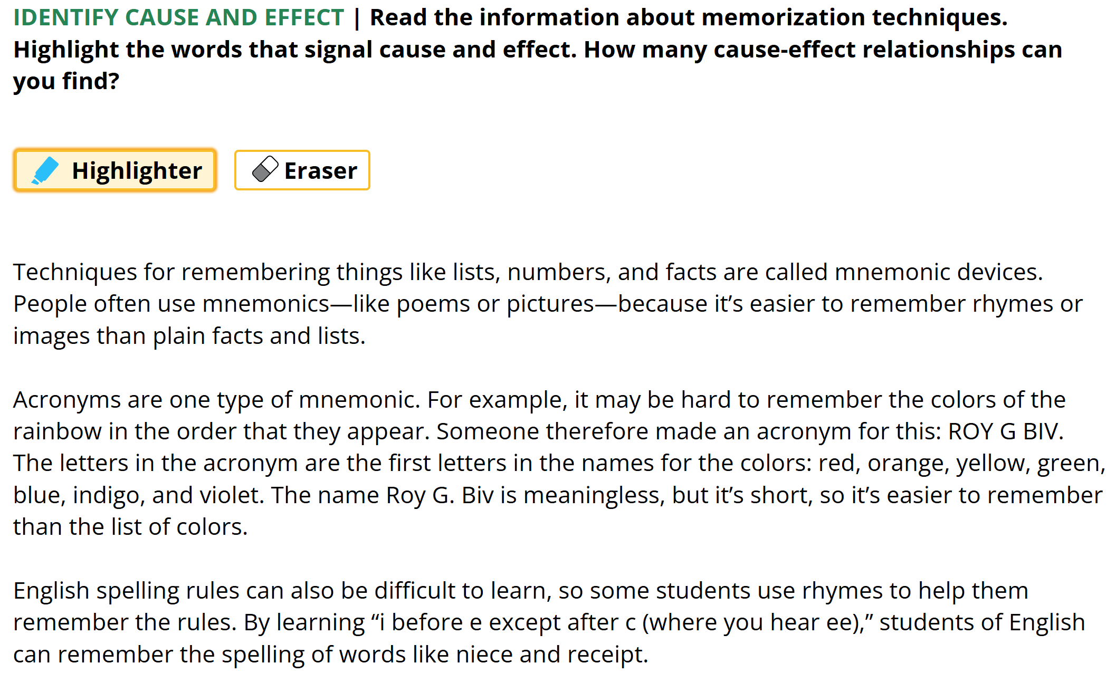




Reading skill 1 – identifying cause/effect – signal words
p. 88

Slide 3
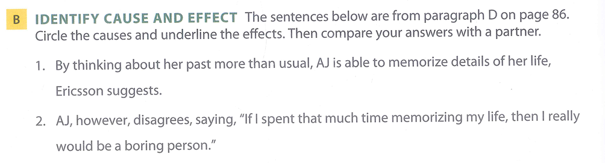
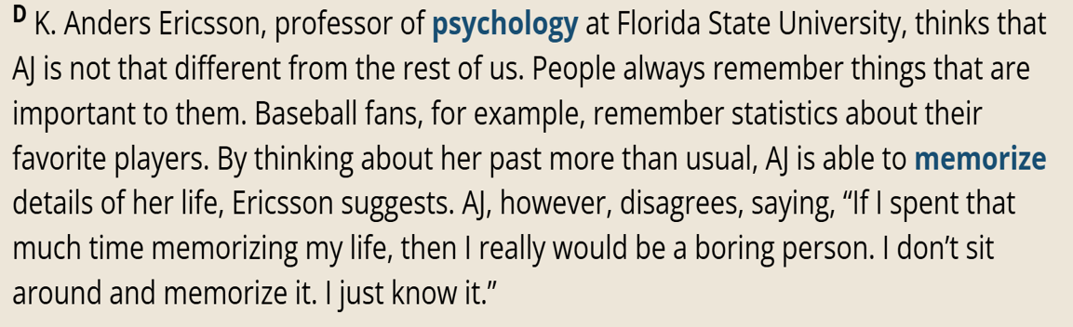

Slide 4
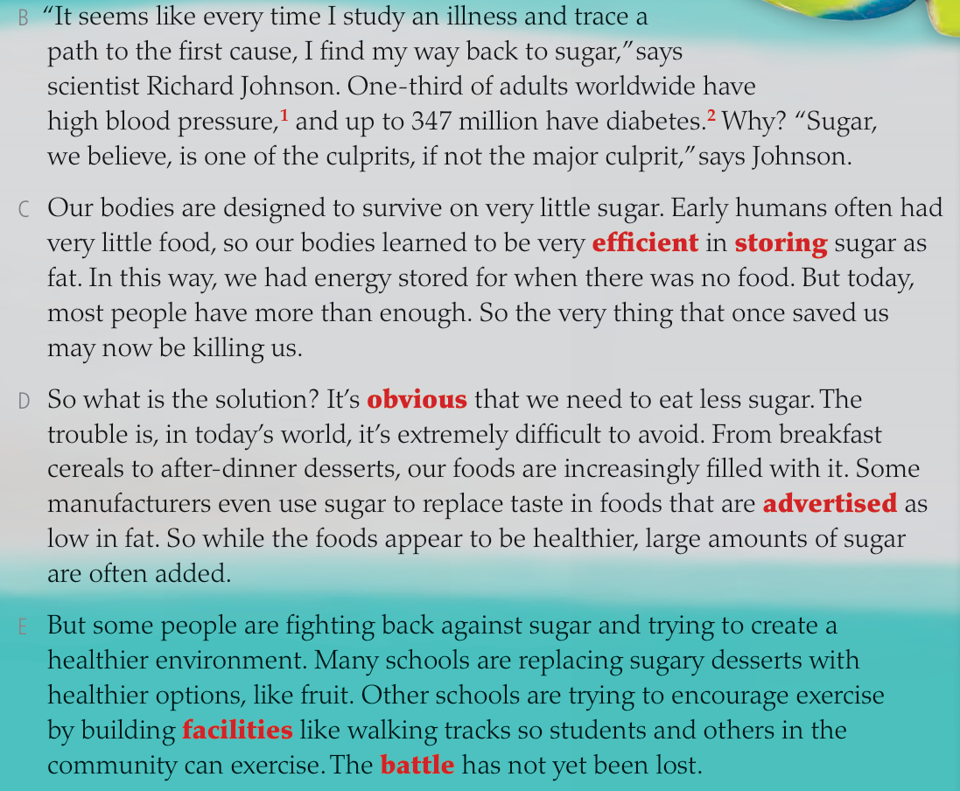
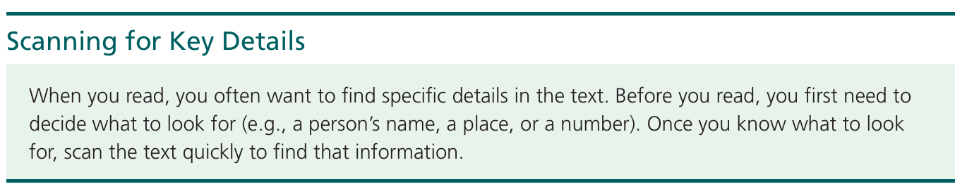
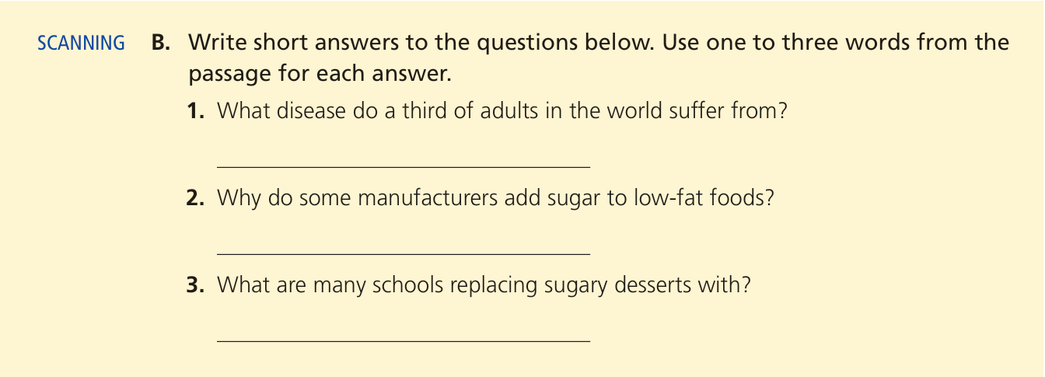







Reading skill 2 – details - short answer questions
Locate the answer
One third of adults worldwide
High blood pressure
For what purpose
Use sugar in food that are advertised as low in fat
To replace taste
Healthier options/ fruit

Slide 5
Unit 5 memory & learning

Slide 6
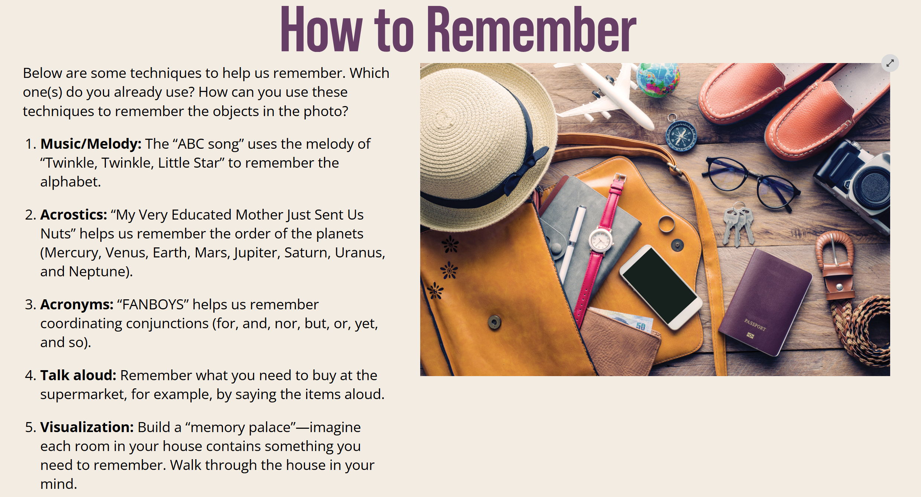

Slide 7
Reading 1 p. 84 - 87

Slide 8
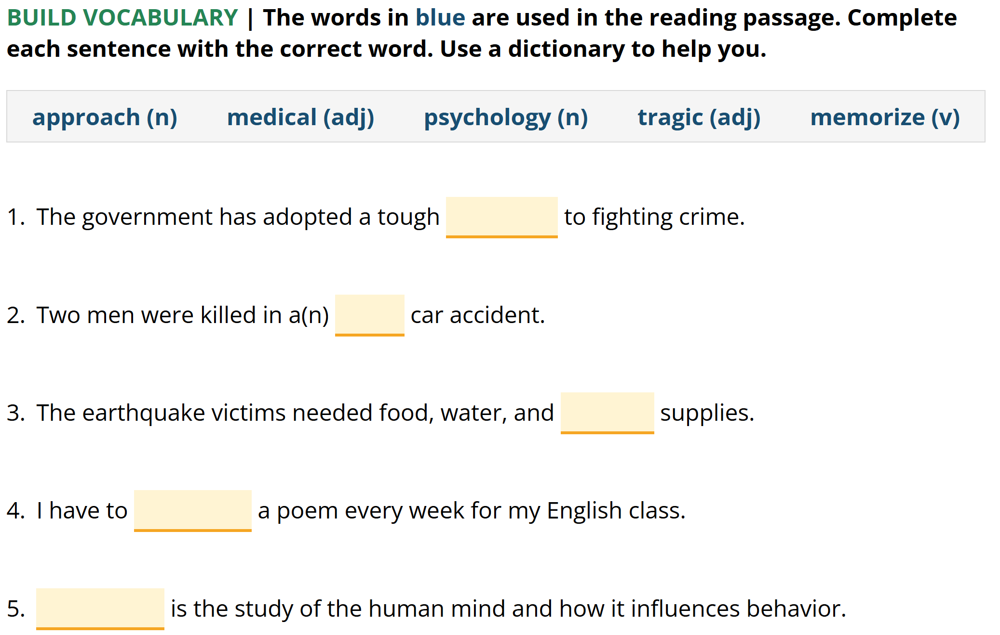
Language development
approach
tragic
medical
memorize
Psychology

Slide 9
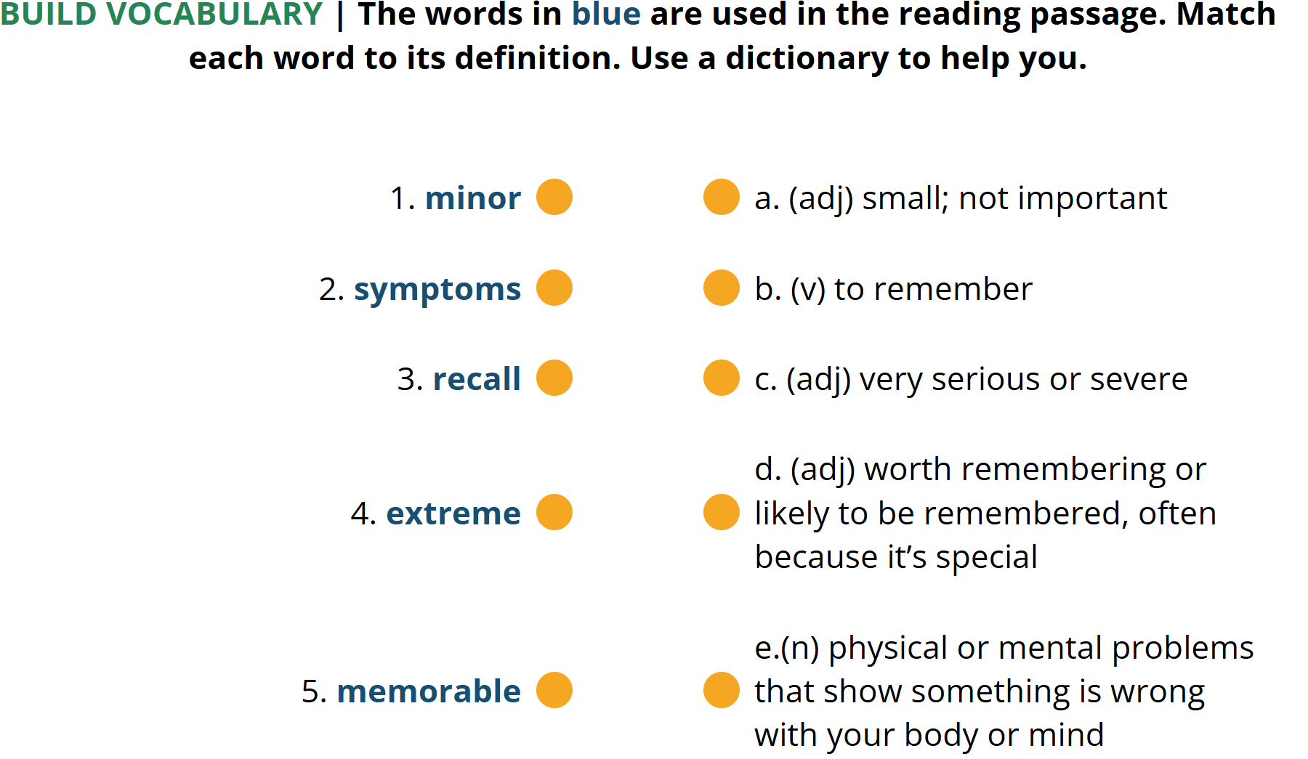
a
e
b
c
d

Slide 10
Reading practice
https://docs.google.com/forms/d/e/1FAIpQLSdIVhVxv0ydINFLtRT3ZTrrIrn_OBc1Vj-Twvr2-kkx_4AQ7A/viewform?usp=publish-editor
GOOGLE FORMS :
Unit 5 – Reading 1 – A & B (Understand the main idea & details) – P. 85 – 87
Unit 4 – Reading 2 – A & B (Understand the main idea & details) – P. 71 -73
TEXTBOOK
Unit 5 – Reading 1 – C (Classify)

Slide 11
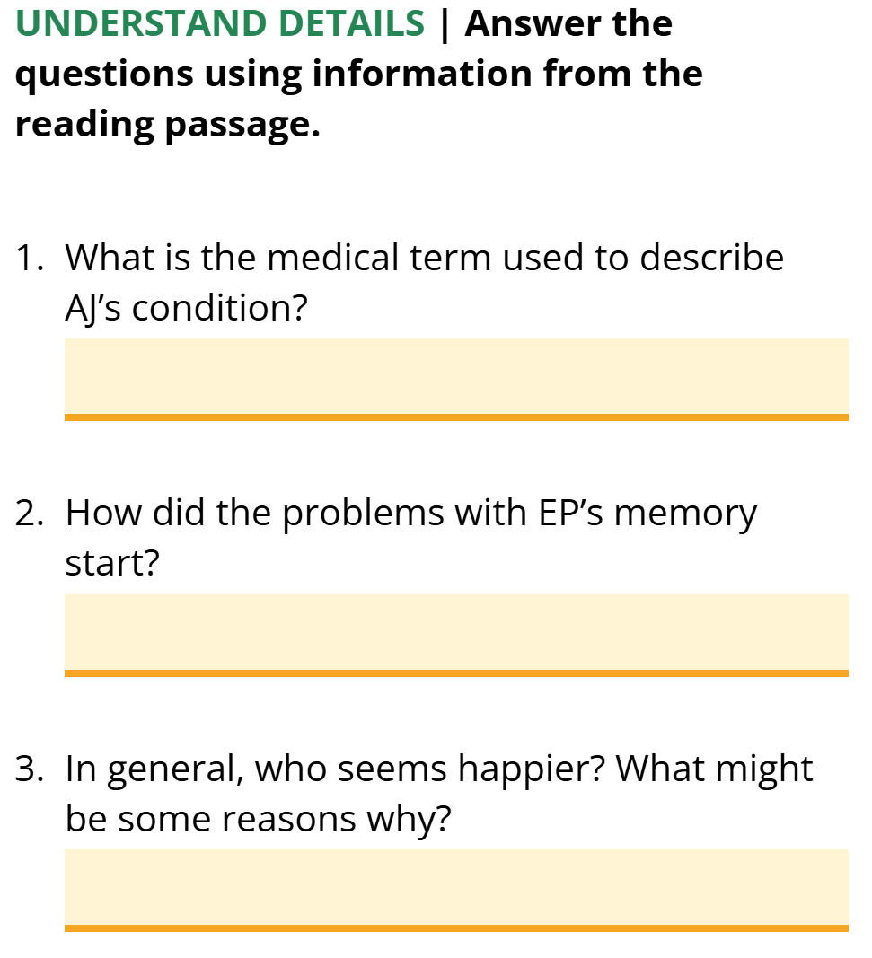
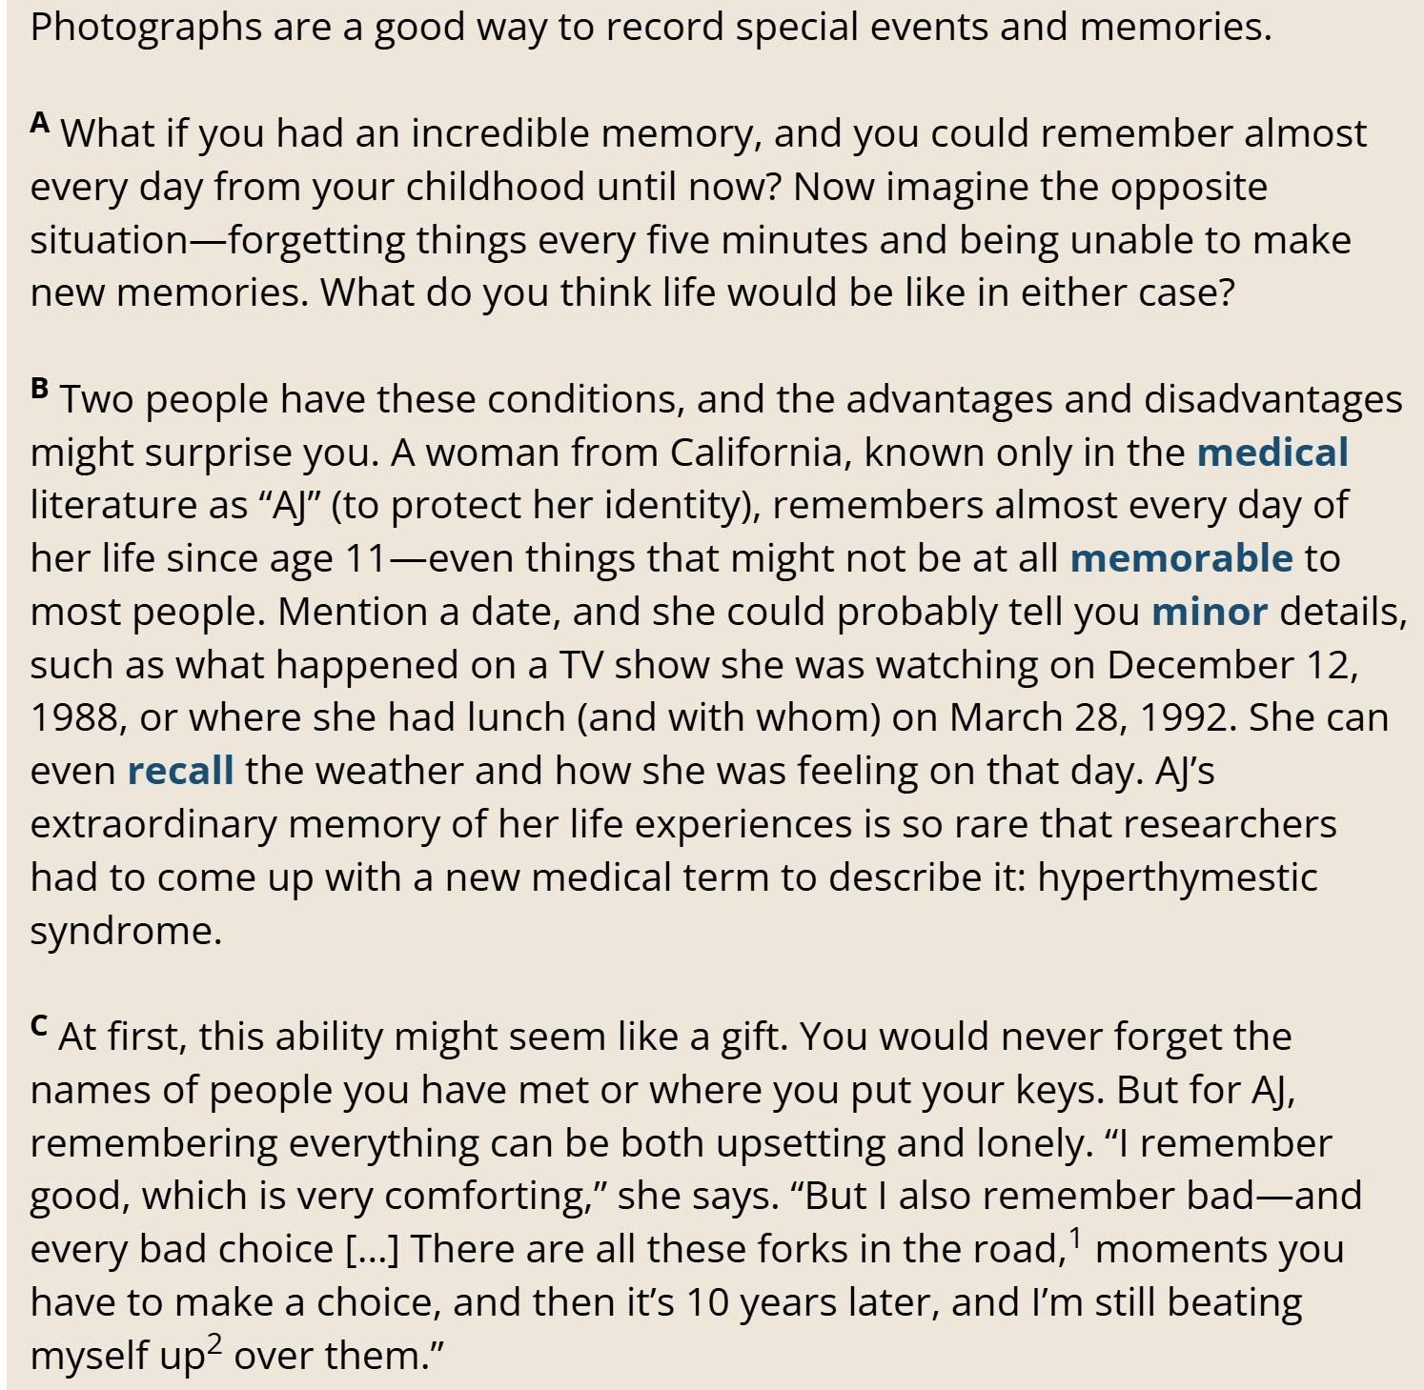


Reading comprehension - details
hyperthymestic syndrome
Condition =

Slide 12
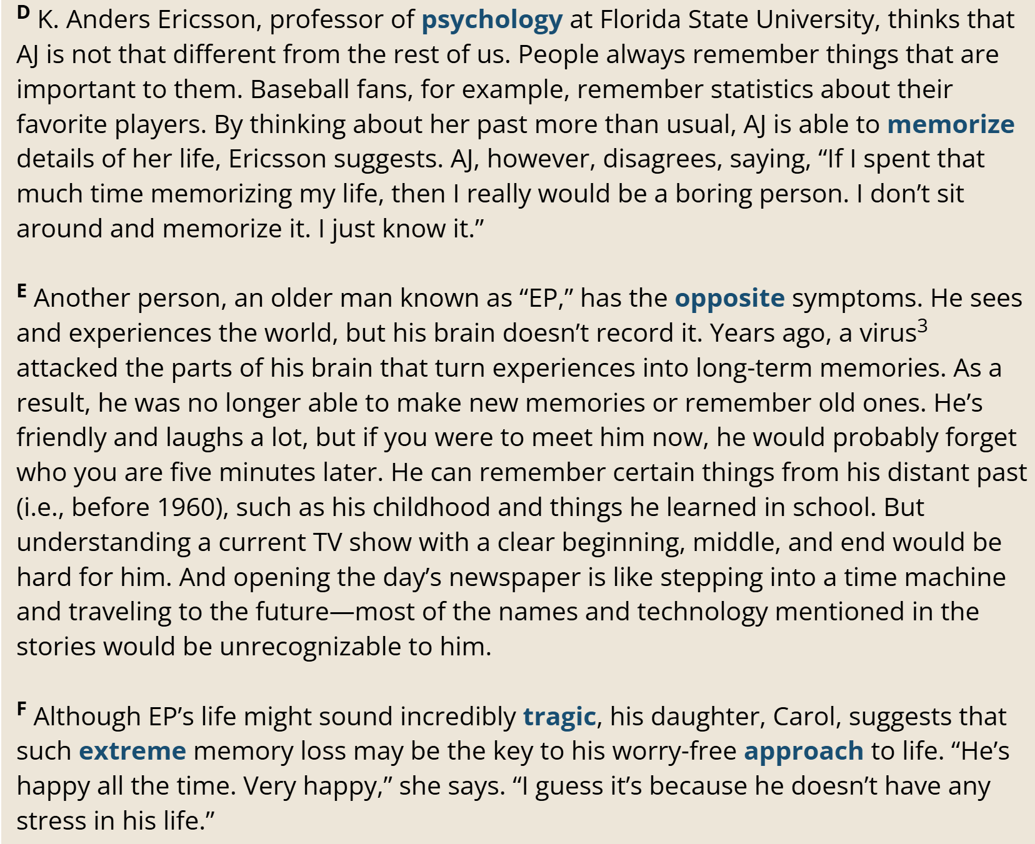





Problem with memory
How/ started
A virus attacked the parts of his brain that turn experiences into long-term memories.
happiness
EP; he doesn’t have any stress in his life.

Slide 13
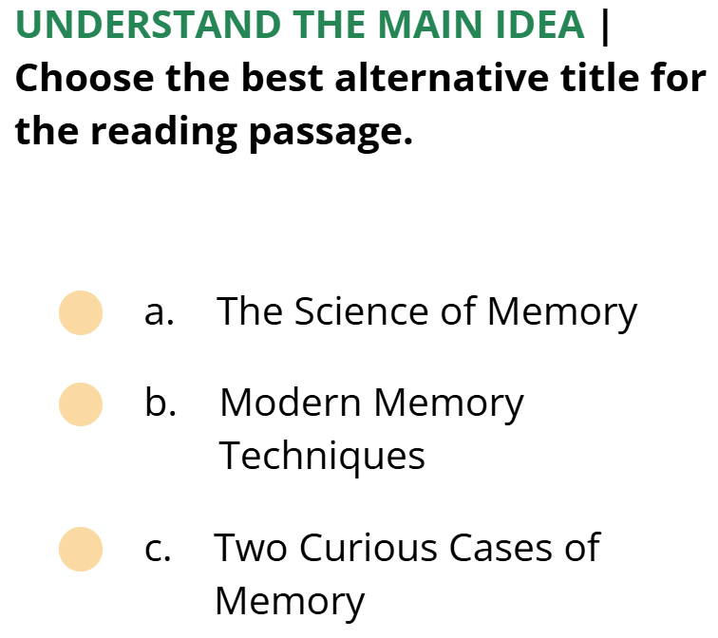
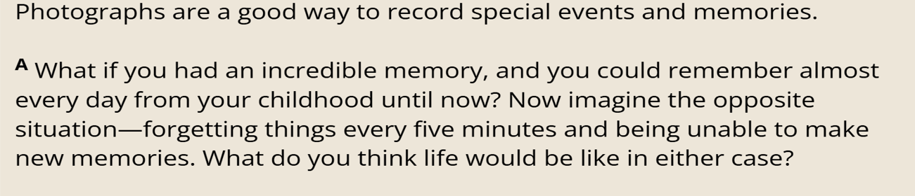
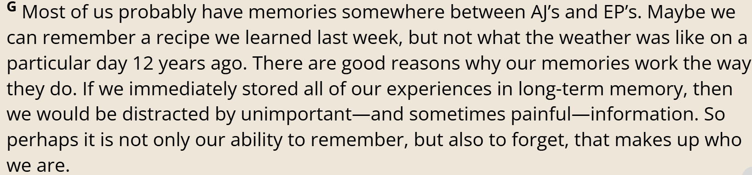
Reading comprehension – the main idea

Slide 14
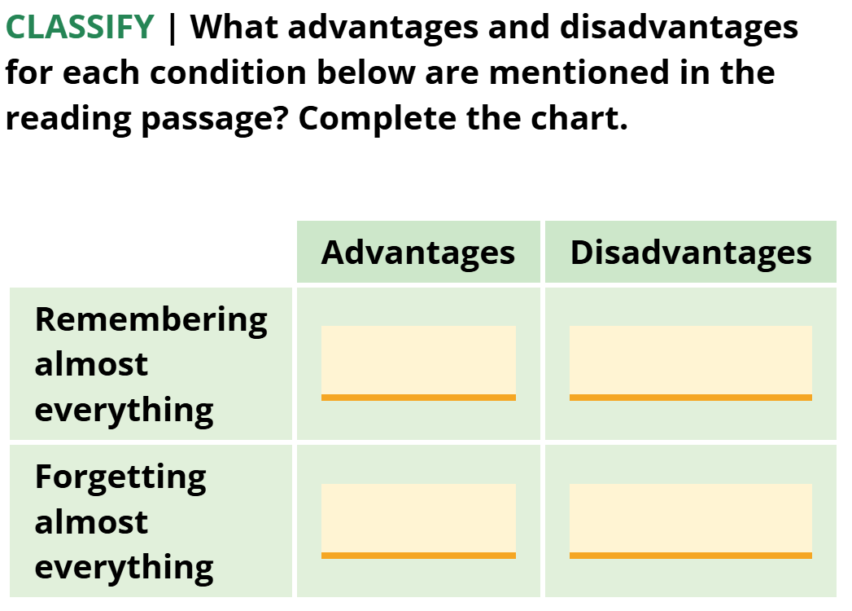
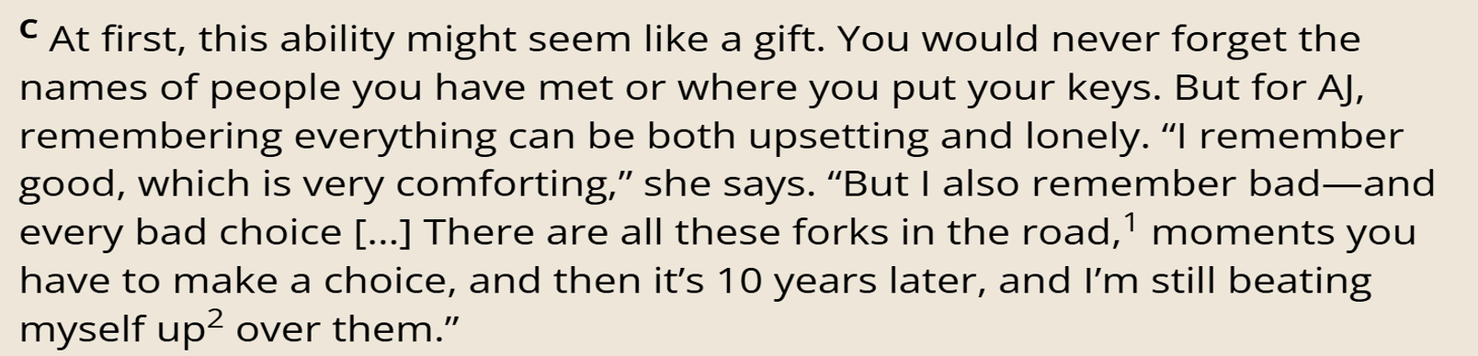


Reading comprehension – details - classify
* won’t forget names of people you have met or where you put your keys;
* can remember good things, which is very comforting
* can be upsetting and lonely;
* can remember bad choices you made in the past

Slide 15
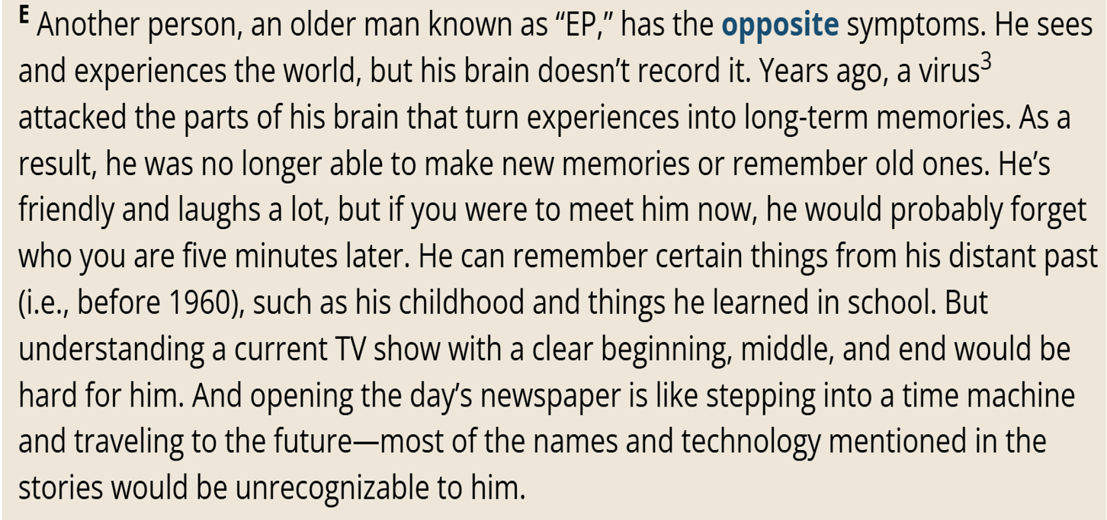
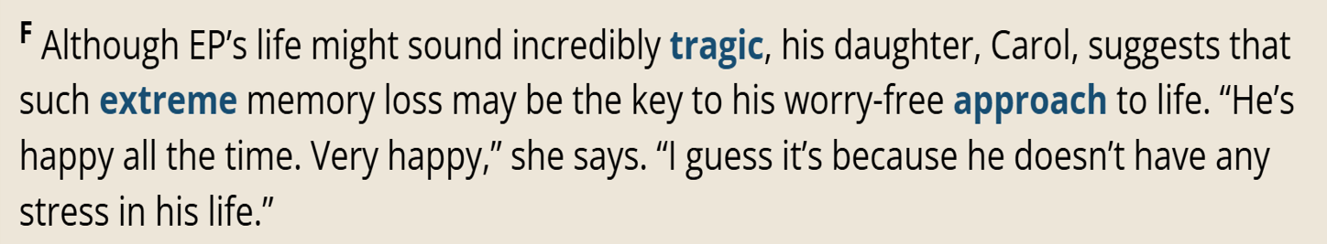


Reading comprehension – details - classify
* won’t forget names of people you have met or where you put your keys;
* can remember good things, which is very comforting
* can be upsetting and lonely;
* can remember bad choices you made in the past
can have a worry-free approach to life; happy because of no stress
* will forget people you have met;
* hard to understand current TV shows and news stories

